Slide 1
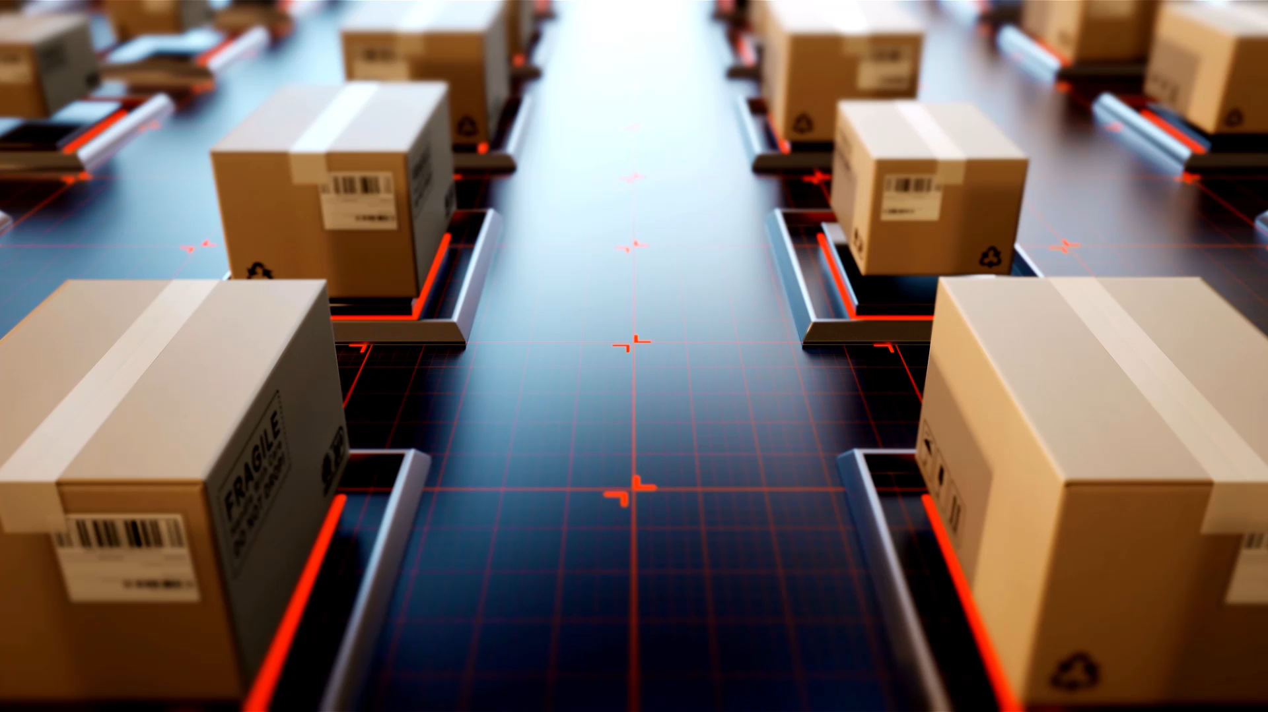
Lane Detection using Image Processing
Name: Samuel Prasad Chinta
DePaul ID: 2049914

Slide 2

Introduction:
Autonomous vehicles are the next big step in the transportation sector due to their efficiency and safety benefits.
A self-driven car needs to understand its surroundings so it can navigate its way in streets with minimal human assistance.
Driver and passenger safety systems are one of the rising topics in automotive development. Lane keep and Steering assist are some of the systems that allow vehicles to detect lanes and help in keeping the car in an ideal position with respect to the road and assist in turning.
There are several works presented on the well-structured roads having proper lane markings, but fewer on unmarked roads.

Slide 3
Facts of lane detection:
Lane Detection System can aid and certain details to the drivers and as well as pedestrians.
Such systems can allow drivers to drive safely and help them to stay on their particular lane by providing some kind of indicators.
According to McKinsey’s report in 2015, the mass adoption of autonomous vehicles could possibly reduce road traffic accidents by 90%.
Since software will drive the car, the modern vehicle can now be programmed to reduce emissions up to 60% according to Ohio University.

Slide 4
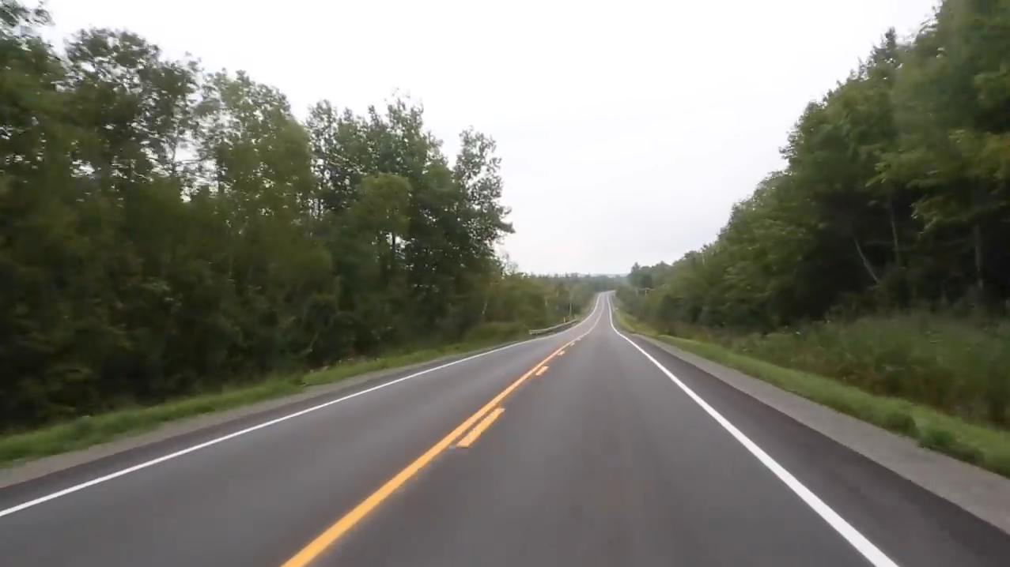
Original Image:

Slide 5
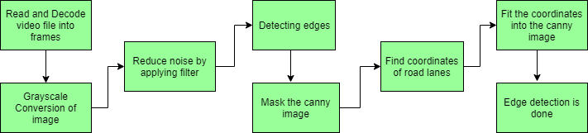
Process

Slide 6
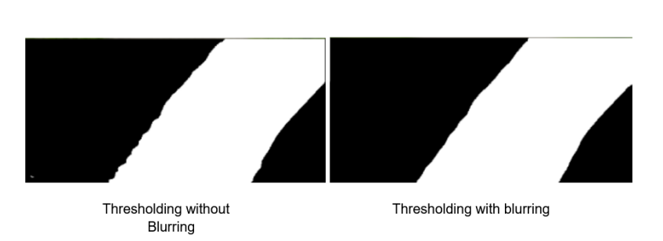
Thresholding comparison: reducing the Nosie

Slide 7

Canny edge detection:

Slide 8
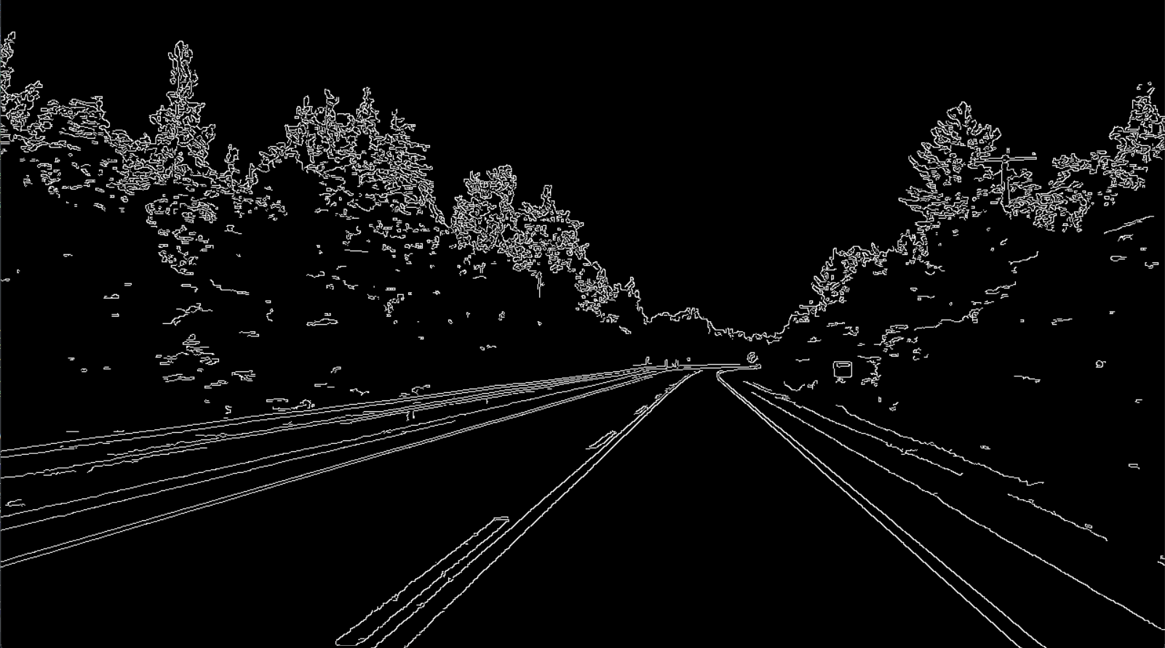
Canny edge detection of the road:

Slide 9

Image Dilation

Slide 10
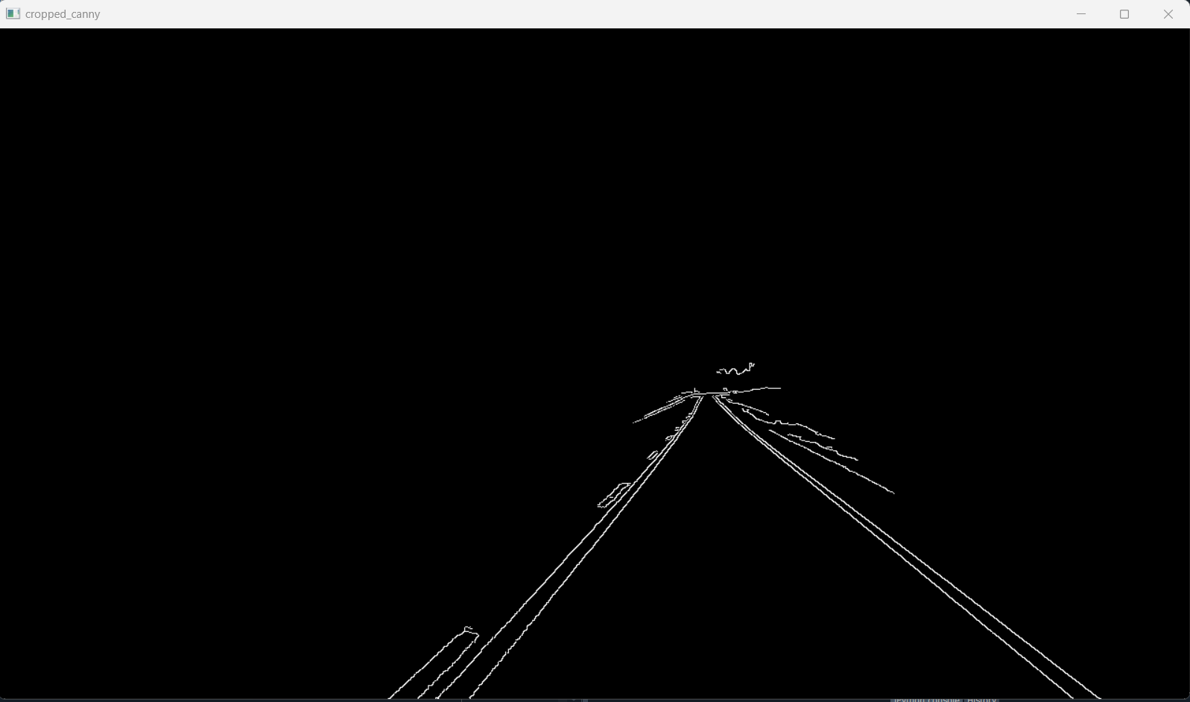
Desired image: ROI has been used here

Slide 11
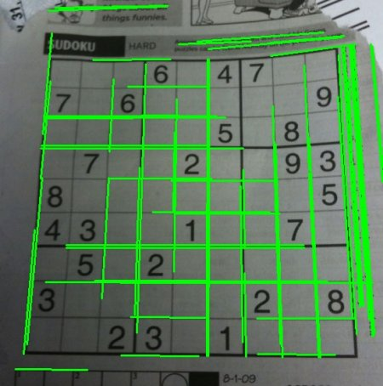
Houghlines algoritham

Slide 12
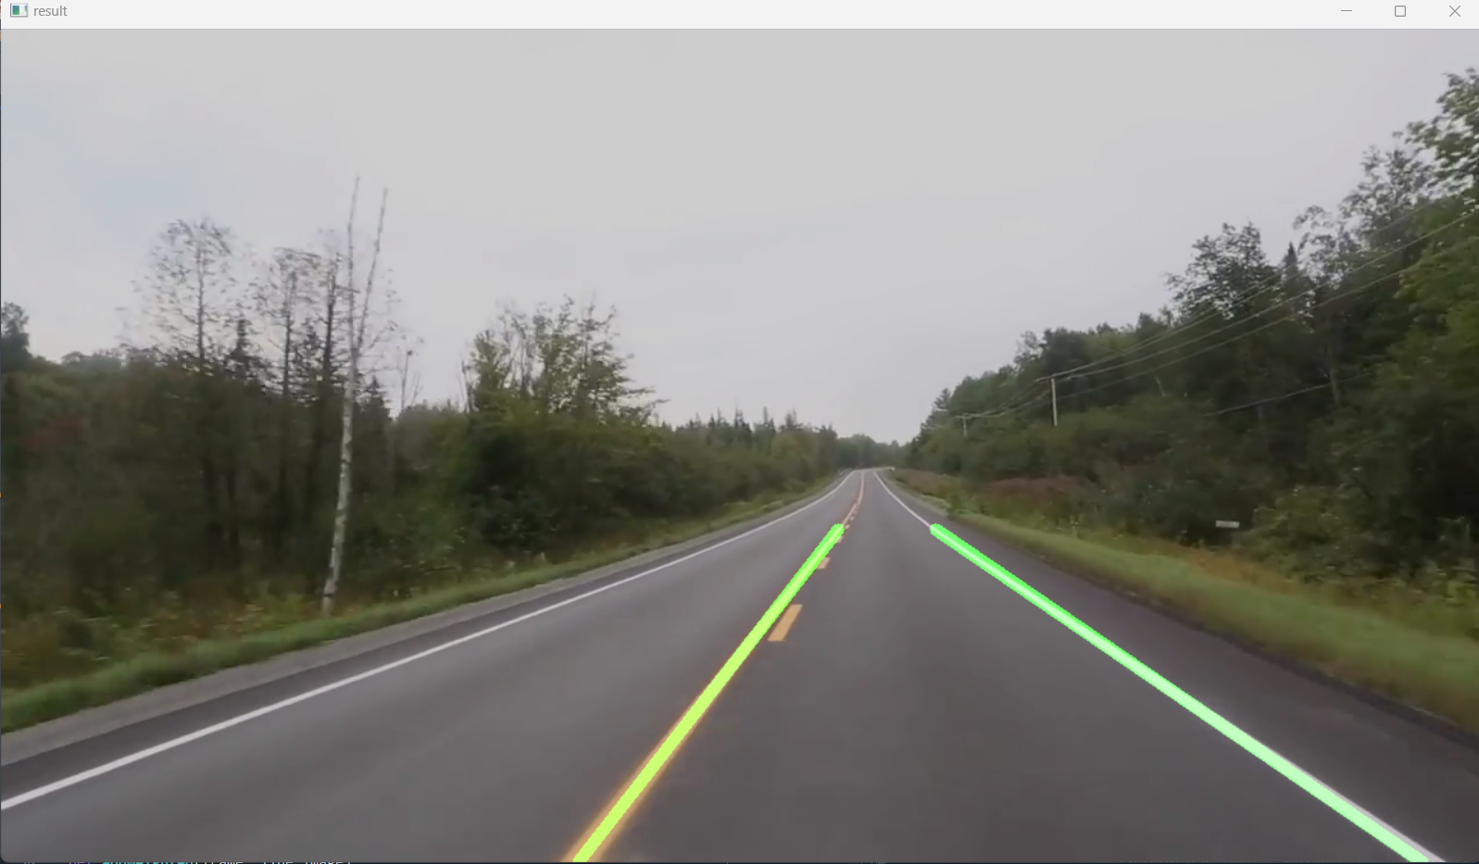
Lane Detection

Slide 13
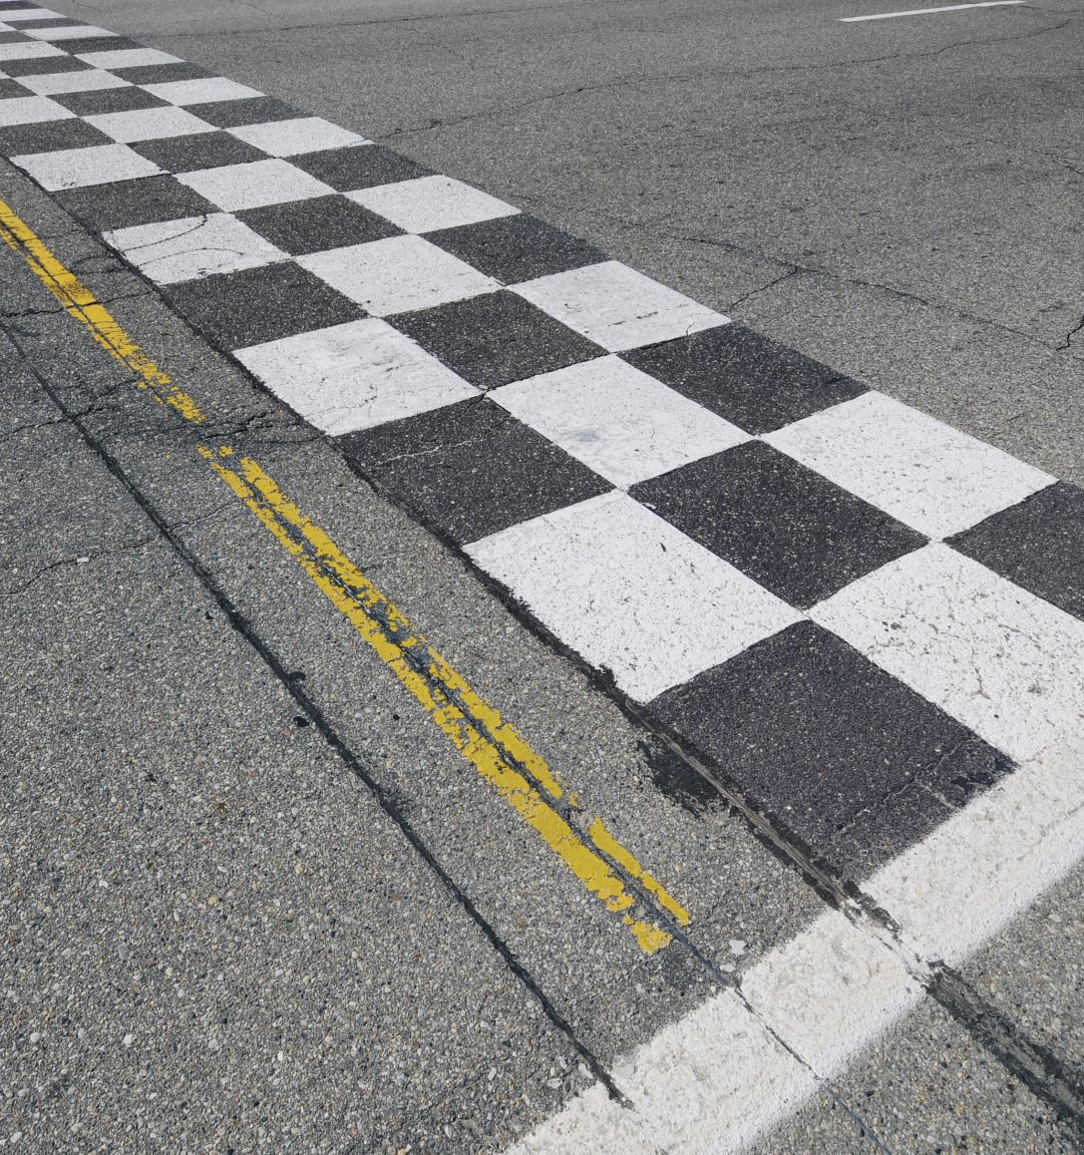
Conclusion:
The overall purpose of this project is to enable lane detection in poor road conditions wherein the lane markings are not clearly visible or worn out.
This project approaches for the implementation of lane detection with the help of image warping, thresholding and approaches such as pixel for an intelligent autonomous vehicle.

Slide 14
References:
https://www.researchgate.net/publication/316450089_Lane_Departure_detection_using_i mage_processing_techniques#:~:text=These%20video%20systems%20use%20image,bo undary%20lines%20using%20artificial%20vision.
https://www.itmconferences.org/articles/itmconf/pdf/2021/05/itmconf_icacc2021_03011.pdf
https://www.geeksforgeeks.org/opencv-real-time-road-lane-detection/

Slide 15
THANK YOU

